Slide 1
Week 6: Navigation Within App
How to Create Multiple Pages and Navigate between Them

Slide 2
Recap From Last Week
Recall The Knowledge from Previous Session

Slide 3
How Do We Make A Button Actually Does Something?
List down all the required steps in order to achieve that.

Slide 4
What Are The Examples of Events?
List out a number of events that are available for WPF applications.

Slide 5
Navigation In WPF
Navigation is life

Slide 6
What is Navigation, And Why?
In common applications, there are usually more than 1 screen (page) for different functionalities.
There can be a few examples for an application such as a login page, a settings page, a home page and a page for some other functions.
While some applications do able to achieve its whole functionality with a single page, in most cases, a developer might want to separate them for more user friendly experience.
And with different pages available, a navigation system is required in order to switch between pages.

Slide 7
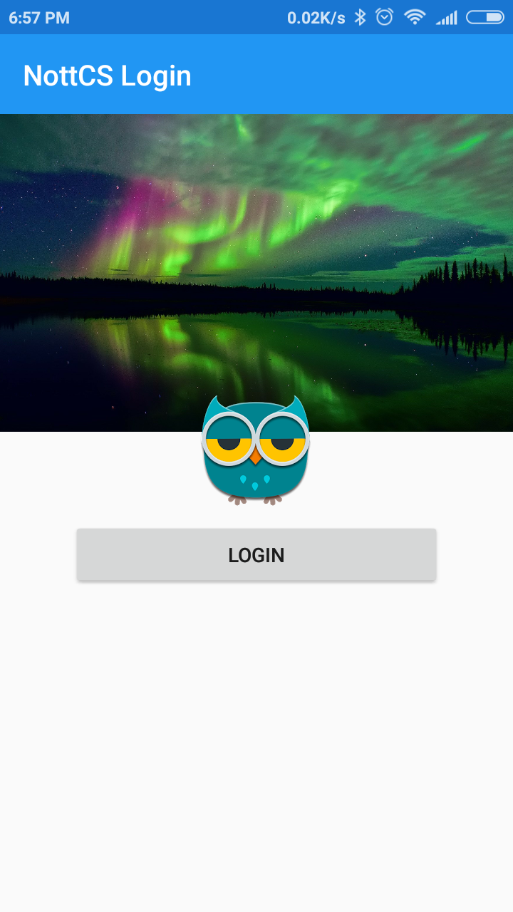
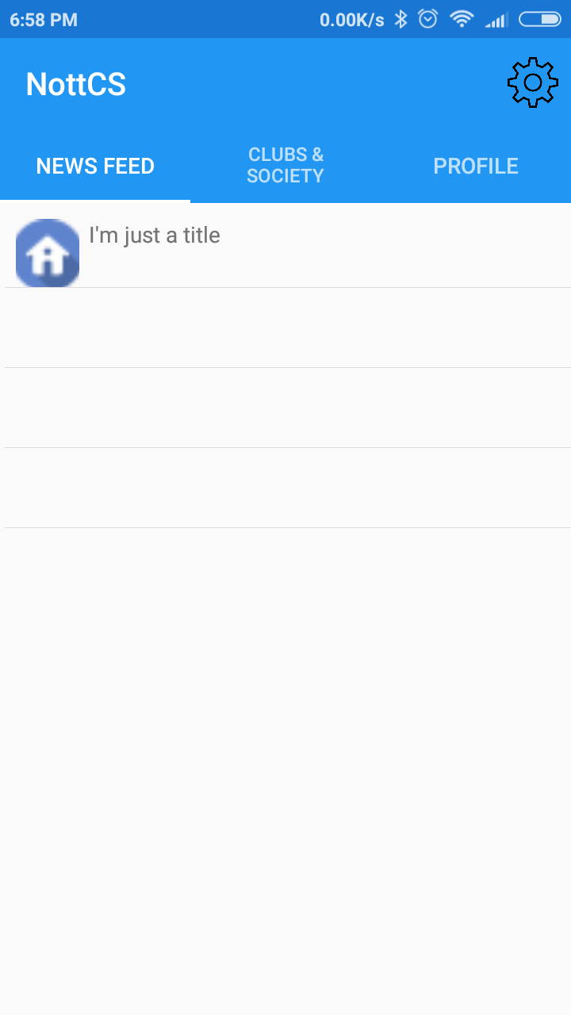
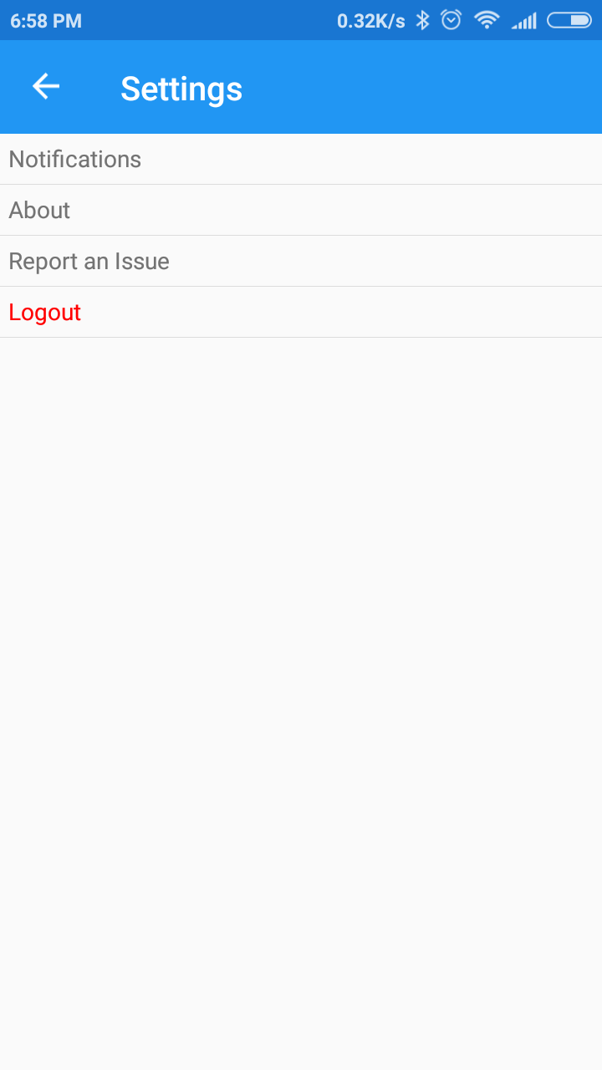


Navigation Example

Slide 8
Basic Concepts For Navigation
Window – An application frame that hosts XAML files
Page – A page/screen
Frame – A container to host pages with navigation functions included

Slide 9
How to create a New Page
Inside the solution explorer, right click the solution and choose “Add New Item”.
In the WPF tab, select page and type in a name for the page.

Slide 10
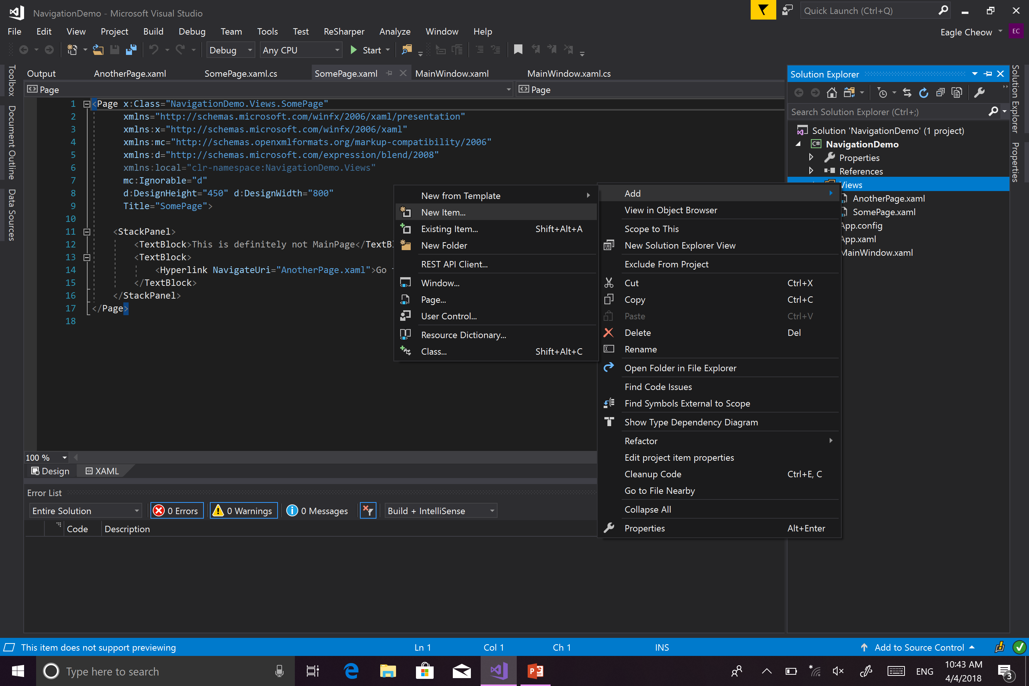
How To Create A Page (Demo)

Slide 11
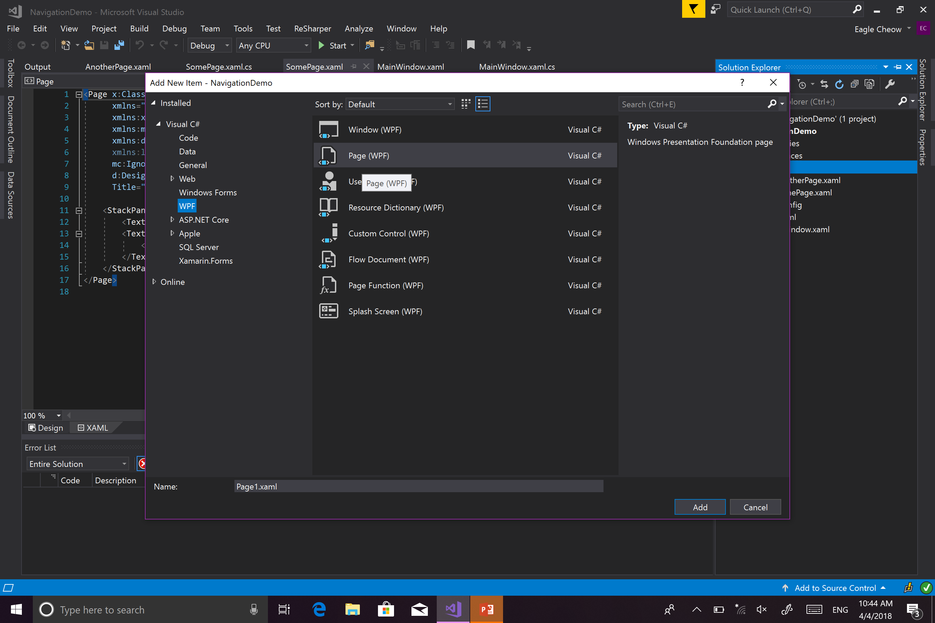
How To Create A Page (DEMO)

Slide 12
How to Navigate to Other PAge
Make sure that your page is wrapped inside a Frame
For the target button action, access the frame component with the navigate property, where the parameter is the new page.

Slide 13

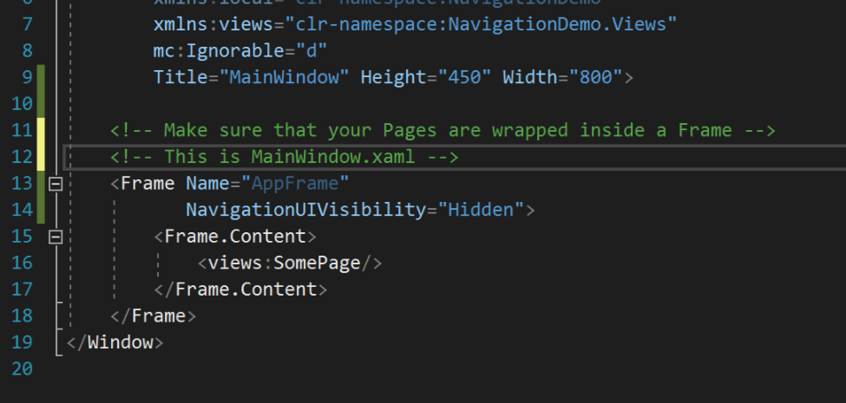
How To Navigate Between Pages (DEMO)

Slide 14
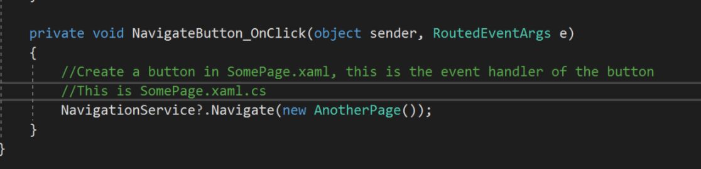
How To Navigate Between Pages (DEMO)

Slide 15
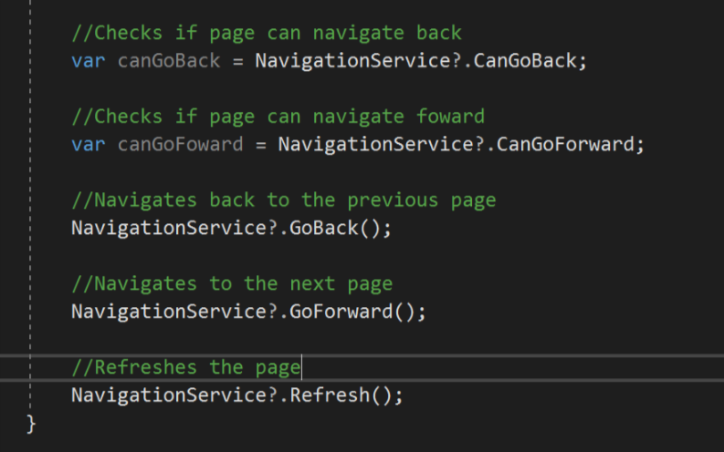
Some Other Useful Navigation Functions

Slide 16
Simple Task
Create two pages and navigate between them!
There should be a button to navigate to the second page.
In the second page, there should be a button to navigate BACK to the previous page

Slide 17
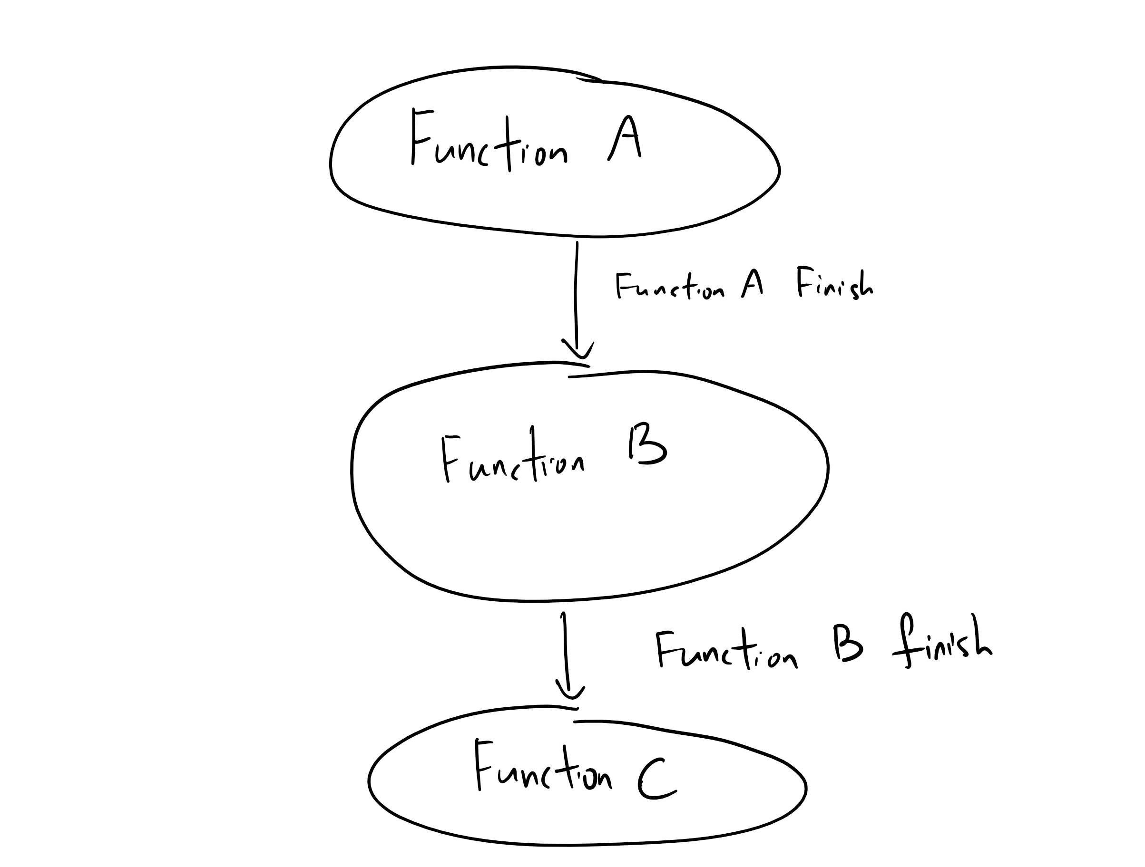
Extra: Speed Up Your Code with Multithreading
In normal C# code, all codes run in a single thread (Synchronous Process).
What if function a takes a really long time, and we have enough resource to do function B and function C?

Slide 18
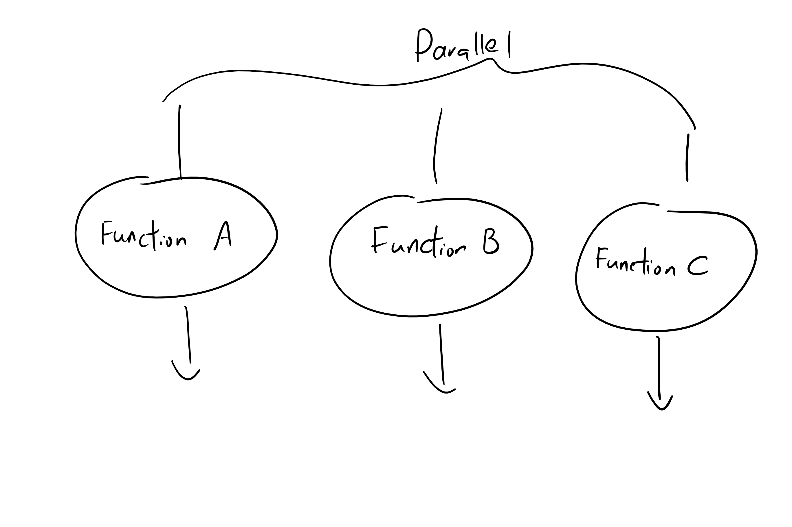
How to DO it Better

Slide 19
Code Example Search From File Included…

Slide 20
Thanks

